Slide 1

Functional Programming: The RPG
Press START to Begin Your Quest for Composability
Notes:
Welcome the audience like they're joining a raid.
"Alright, everyone ready? Buffs applied? Good."
Set the tone: this is going to be fun, educational, and NOT another boring lecture.

Slide 2

You Are Here: The Callback Hell Dungeon
You've battled async/await. You've survived Promise chains.
You've stared into the abyss of nested callbacks...
...and the abyss stared back (with a TypeError)
You've googled "what is a monad" at 2am. We all have.
Today, we finally defeat the boss: CONFUSION
Notes:
This is the "I see you" moment. Everyone relates to callback hell.
Reference: "Like that one Dark Souls boss you can't beat..."
Make them feel seen, not judged.

Slide 3
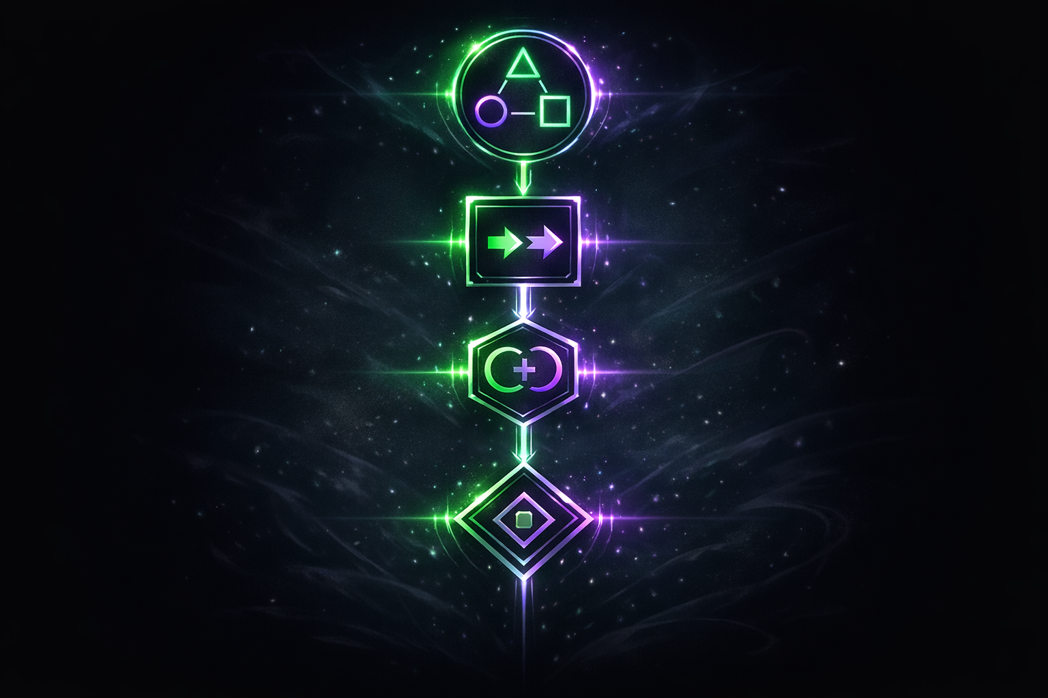
Today's Skill Tree
SKILLS TO UNLOCK:
Category Theory (+10 Composability)
"It's just objects and arrows. That's it. That's the whole thing."
Functors (+15 Transformation)
"You already use these. It's called .map()"
Monoids (+20 Combination)
"Things that smoosh together nicely"
Monads (+25 Superpowers)
"The boss level. But you're ready."
Notes:
Show the roadmap. Gamify the learning.
"Each of these builds on the last. By the end, you'll have a complete build."
Reference: Skill trees from any RPG.

Slide 4
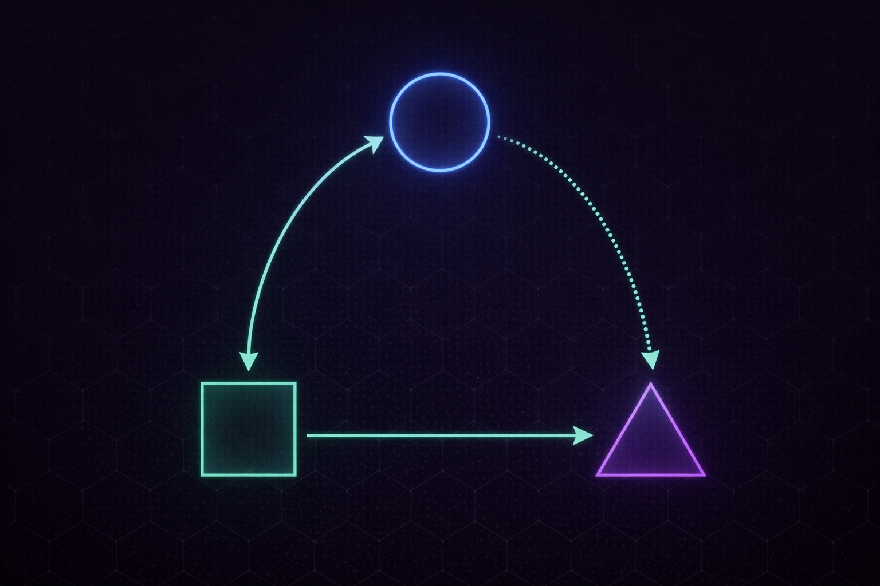
Category Theory: The Tutorial Level
LORE DROP:
Category = A collection of things and connections between them
Objects = The things (could be types, sets, anything)
Morphisms = The connections (functions, transformations)
Composition = Chaining connections (f then g then h)
Developer Translation:
It's literally just: things with functions between them
You're already living in categories. Every. Single. Day.
Notes:
Key insight: Make it click that they already know this.
"When you write a function that takes A and returns B, you're creating a morphism."
Reference: "It's like the tutorial level of an RPG - you're learning the controls."

Slide 5
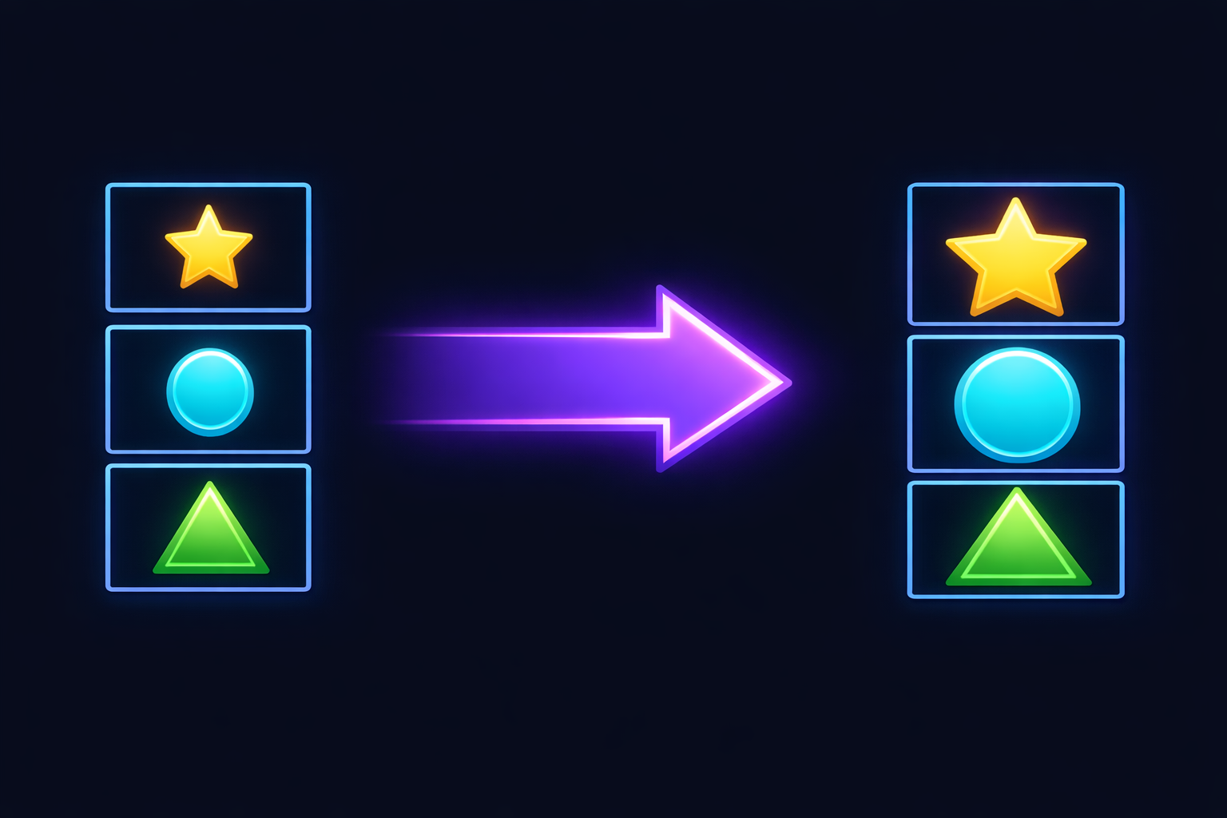
Functors: You've Already Got This Skill
ABILITY UNLOCKED: FUNCTOR
[1,2,3].map(x => x * 2) gives you [2,4,6]
That's it. That's a Functor. You've been using them.
The Pattern:
Take thing in container
Apply function to thing
Get new thing in SAME container type
Common Containers:
Array | Promise | Option | Result | Observable
Notes:
This is the "You already knew this" revelation.
"Remember all those .map() calls? Functor. Every single one."
Make them feel smart, not overwhelmed.

Slide 6

Monoids: The Art of Smooshing
ABILITY UNLOCKED: MONOID
Things that combine with a "nothing" element
Examples You Know:
Numbers + 0 equals Addition (0 is identity)
Strings + "" equals Concatenation ("" is identity)
Arrays + [] equals Concat ([] is identity)
Functions + id equals Composition (id is identity)
Video Game Translation:
It's like item stacking in your inventory
Combining two health potions = bigger health potion
Combining with "nothing" = same thing back
Notes:
The inventory metaphor works great here.
"Think about how items stack in games. That's a monoid."
The identity element is like having 0 of something.

Slide 7
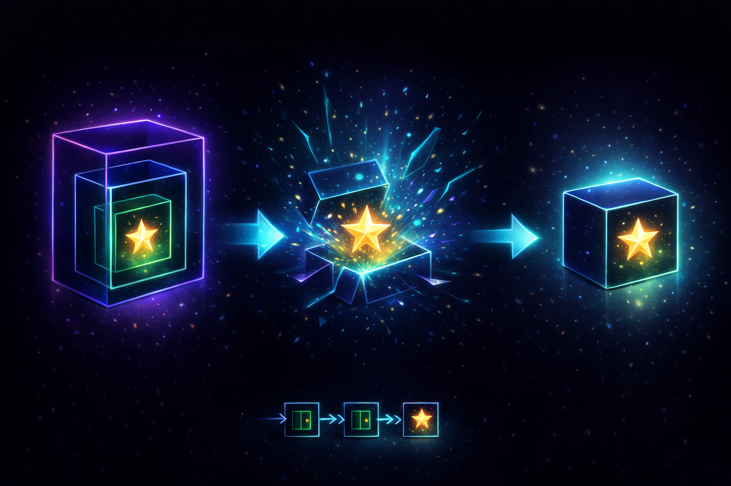
Monads: The Final Boss (You're Ready)
FINAL ABILITY: MONAD
A Functor that can also flatten nested containers
Promise.then() chains? That's a Monad.
.flatMap() / .SelectMany()? Also Monad.
The Pattern:
map: A<B> to (B to C) to A<C>
flatMap: A<B> to (B to A<C>) to A<C> This is the magic
Boss Battle Translation:
When functions return wrapped values, you need flatMap
It unwraps, applies, and rewraps in one move
No more Promise of Promise of Promise...
Notes:
This is the climax. Build it up but also demystify it.
"You've been fighting this boss in disguise. Every .then() chain."
The reveal: You already beat this boss. You just didn't know it had a name.

Slide 8

Proof: You've Been Doing This
REAL CODE YOU'VE WRITTEN:
Functor (map):
users.map(u => u.name)
Monoid (combine with identity):
strings.reduce((a,b) => a + b, "")
Monad (flatMap):
users.flatMap(u => u.friends)
Promise.resolve(1).then(x => Promise.resolve(x + 1))
ACHIEVEMENT UNLOCKED: Functional Programmer
Notes:
The "proof" slide. Show actual code they've written.
"Look familiar? You've been a functional programmer all along."
This is the empowerment moment.

Slide 9

The Complete Build: Your New Toolkit
THE MAP (It All Connects):
Category Theory is the framework
which leads to Functors for transforming contents (preserve structure)
which leads to Monoids for combining things (with identity)
which leads to Monads for handling nested complexity (flatten)
which leads to YOUR CODE being cleaner, composable, debuggable
GAME COMPLETE: New Game+ unlocked
Notes:
The synthesis slide. Show how it all connects.
"This is your complete character build."
Reference: "Ready for New Game+ - you can apply this to any project."

Slide 10
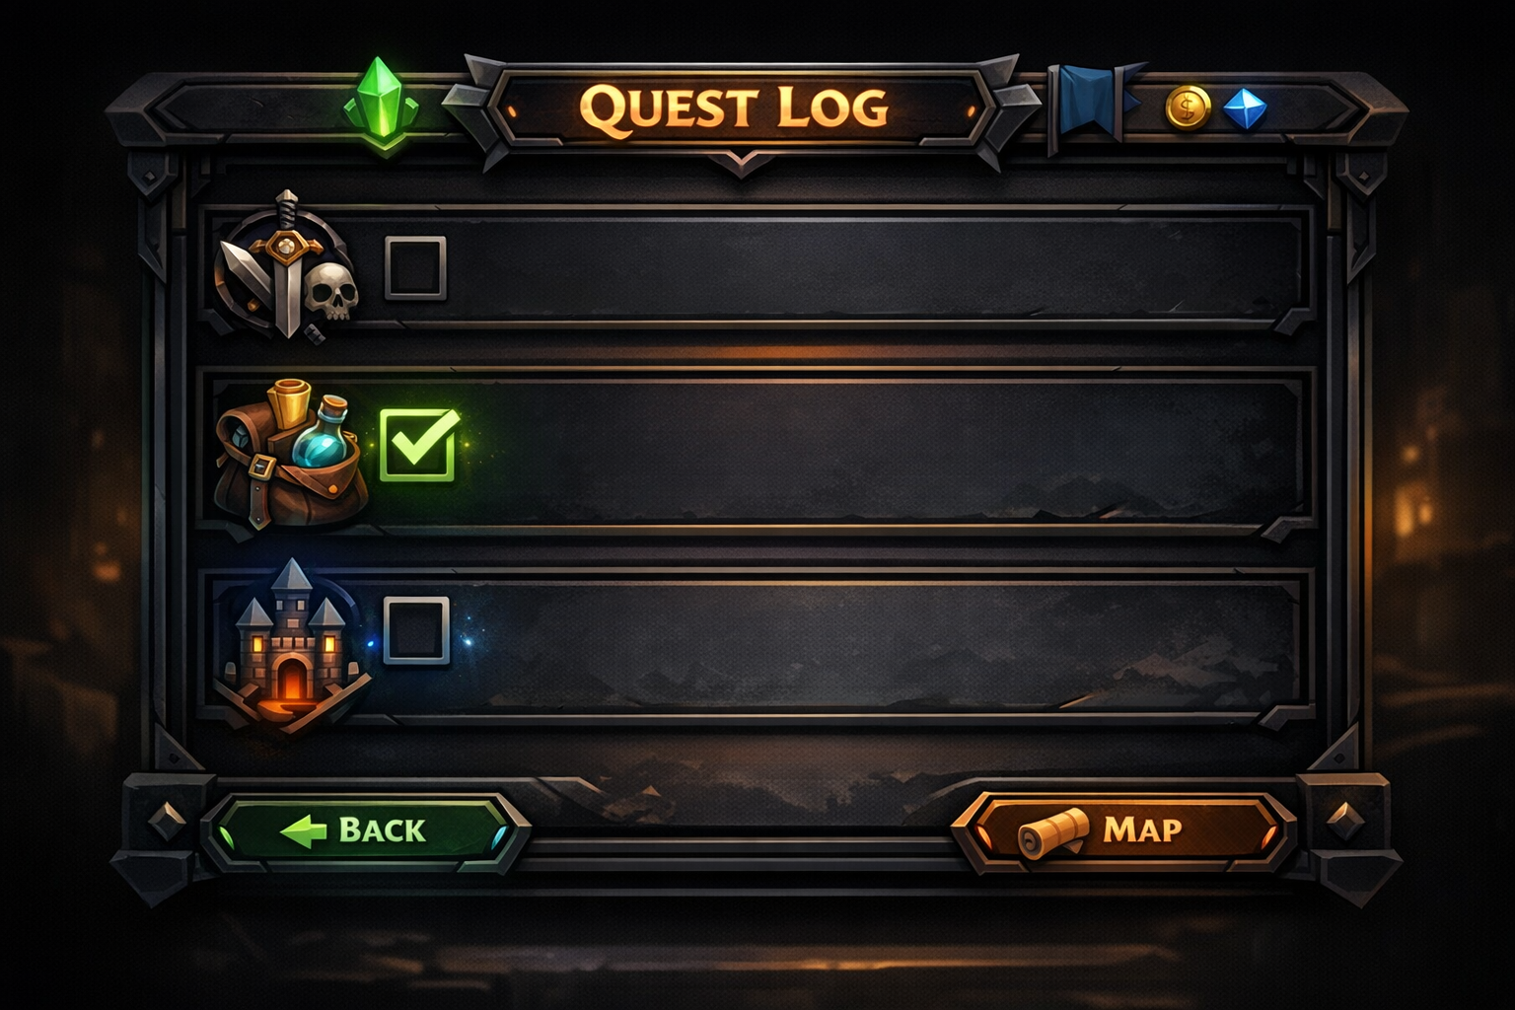
Your Quest Continues: Next Steps
SIDE QUESTS TO ACCEPT:
Immediate:
Use .map() consciously (it's a Functor!)
Notice when you're combining things (Monoids everywhere)
Reach for .flatMap() when you see nesting
Level Up Further:
Try fp-ts (TypeScript) or Effect (TS)
Explore Rust's Result and Option types
Check out Elm or Haskell for pure FP
Achievement: Share this knowledge (XP boost)
Notes:
Actionable takeaways. Give them quests to complete.
"These are your side quests. They're optional, but highly recommended."
End on empowerment, not overwhelm.

Slide 11

Questions? (I Accept Side Quests)
No question is too basic.
Remember:
"What's a monad?" is a valid question (always)
"I still don't get functors" is also valid
We've all been confused. It's part of the journey.
Notes:
Open for Q&A. Be welcoming.
"Think of this as the NPC dialogue where you can ask anything."
No judgment zone.

Slide 12

GG WP! Thanks for Joining the Party
CAMPAIGN COMPLETE
You've unlocked:
Category Theory basics
Functor understanding
Monoid pattern recognition
Monad demystification
Achievement: Functional Programming Awareness
Now go compose some functions!
Notes:
Warm close. Celebrate their participation.
"GG everyone. Thanks for being here."
Reference: End credits of a game.

